Slide 1
Visualisation of Design Space Exploration using Virtual Reality
Project Presentation

Slide 2
Presentation Overview
Background Research
Cyber and Physical Data
Design Space Exploration
Aims and Objectives
Plan and Progress
Project plan
INTO-CPS
Concluding points

Slide 3
Background Research:
Cyber and Physical Data and Design Spaces
Complexity of Cyber Physical data
Cyber and Physical Systems interlink physical (discrete) and digital worlds (continuous), which are connected using heterogeneous and non deterministic networks. (Al-Hammouri, A.T. (2012, p. 8))
Each domain thrives in its own culture and abstractions. (Fitzgerald, J. et al. (2016, p. 8))
Design space exploration (DSE)
Design space exploration is the systematic alteration of design parameters. (Gries, Matthias (2004, p. 134))
Motivation to use: For increasingly complex designs and heterogeneous systems (e.g. use in microprocessing cyber physical data) (Gries, Matthias (2004, p. 133))
Challenges: Design space sizes can be very overwhelming, which makes them difficult to interpret. (Kokhazadeh, A. & Fatemi, O. (2011, P. 550))
Notes:
-Complexity of Cyber Physical System
-Interlinked Cyber and Physical Worlds
-Examples (Medical Systems, Auto)
-Domain differences
-Examples (Discrete, Continuous, different models (software vs hardware), completely different subject/research)
-Design Space Complexity
-DSE Def
-Microprocessing links
-Examples
-ADV
-DSADV (include others e.g. storage)

Slide 4
Background Research:
Virtual Reality and Data Representation
“Different representation models according to human perception preferences can be chosen, it allows immersion, it creates a living experience, it is broad and deep, and for using VR the user needs no mathematical knowledge and no special skills.” (Valdés, Romero & Barton, (2012, p. 13193))
More direct control simpler control and immersion might allow for an environment where Design spaces can be better illustrated.
Challenges (Velev, D. & Zlateva, P. (2017, p. 36)):
Hardware requirements: VR may require intensive graphic capabilities
Training and usage issues: VR is still a new technology
Notes:
-VR advantages (immersion, living experience, easy)
-Multiple Advantages with examples
-Challenges + others (Expensive, new)
-Link to report

Slide 5
Project Aims, Objectives and Hypothesis
Aim: Illustrate the design space exploration process through visualisation using Virtual Reality equipment
Objectives:
Design a tool to illustrate design spaces using multiple dimensions
Review and work around risks and limitations of data representation with Virtual Reality equipment
Illustrate the multidimensional design space using Virtual Reality hardware
Illustrate the effects of changing design space dimensions in a design space in a Virtual Reality environment

Slide 6
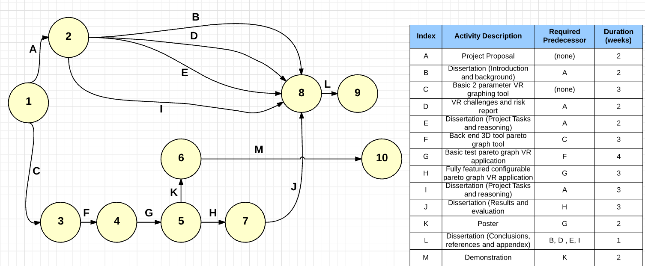
Project Plan
Establishing an base:
Exploration of tools and basic data visualization with Virtual Reality headsets
In this stage 2 dimensional parameters are considered.
Establishing the back end
Linking backend to virtual reality
Notes:
-Introduce basic pert graph
-Project tasks
-Dissertation tasks
-Poster and demo

Slide 7
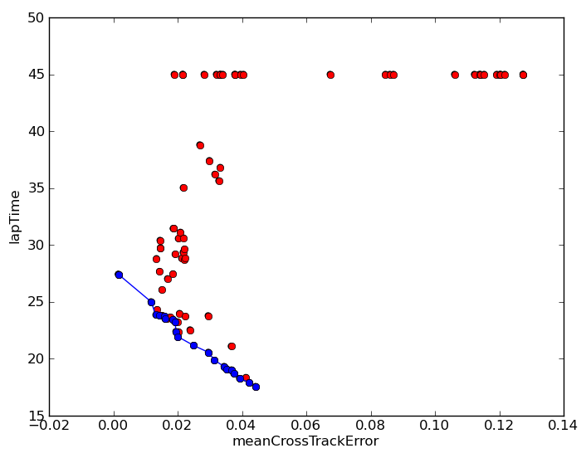
Current progress: INTO-CPS and Co-Simulation
INTO CPS project used to create a toolset for co simulation using FMI interface. (Lausdahl, K et al. (2015, p. 8))
Uses design space exploration to optimize design (e.g. finding best sensor location for trailing robot):
Can we illustrate this data better with VR?
Notes:
- Introduce INTO-CPS
FMI and FMUs with examples
Design space implementation in INTO-CPS
Introduce experiment
Talk about the data
Suggestions for improvement (3D pareto, remove clusters of data, change the colours/shape, changing parameters, flipping, introduce other graphs) Basically more control

Slide 8
Conclusions and key points
Physical and Cyber Systems combine the discrete nature of the cyber world, continuous nature of the physical world. They connected by complex network
Design Space Exploration enables analysis of complex data
Virtual Reality enables a more natural, simpler and more hands on experience with data analysis
Virtual Reality comes with its own challenges that need addressing
Potential of Virtual Reality in the INTO-CPS toolset and other similar toolsets

Slide 9
Citations
Citations used in presentation:
1- Valdés, Romero & Barton, 2012. Data and knowledge visualization with virtual reality spaces, neural networks and rough sets: Application to cancer and geophysical prospecting data. Expert Systems With Applications, 39(18), pp.13193–13201.
2- Kokhazadeh, A. & Fatemi, O., 2011. Design space pruning of MPSoCs using weighted sub-sampling. Electronics, Circuits and Systems (ICECS), 2011 18th IEEE International Conference on, pp.550–553.
3- Gries, M., 2004. Methods for evaluating and covering the design space during early design development. Integration, the VLSI Journal, 38(2), pp.131–183.
4 -Al-Hammouri, A.T., 2012. A comprehensive co-simulation platform for cyber-physical systems. Computer Communications, 36(1), pp.8–19.
5- Fitzgerald, J., Gamble, C., Payne, R., Pierce, K. (2016) Method Guidelines 2. D3.2a, INTO-CPS project (644047).
6-Lausdahl, K., Larsen, P. G., Wolf, S., Bandur, V., Terkelsen, A., Hasanagić, M., Hansen, C. T., Pierce, K., Kotte, O., Pop, A., Brosse, E., Brauer, J., Möller, O. (2015) Design of the INTO-CPS Platform. D4.1d, INTO-CPS project (644047).
7-Velev, D. & Zlateva, P., 2017. Virtual Reality Challenges in Education and Training. International Journal of Learning and Teaching, pp.33–37.

